Slide 1
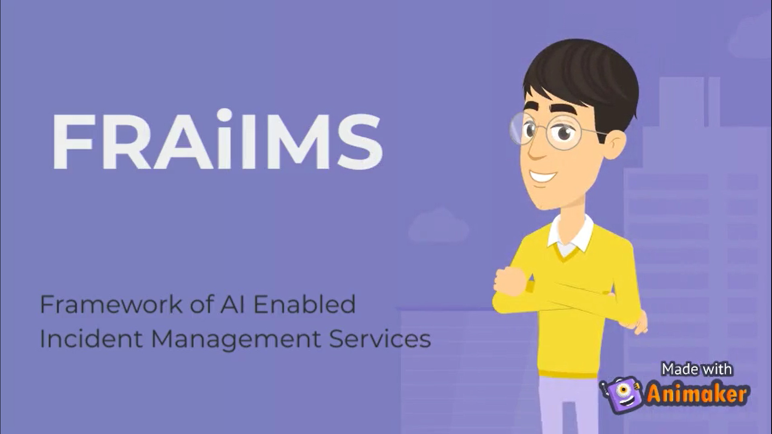

Slide 2
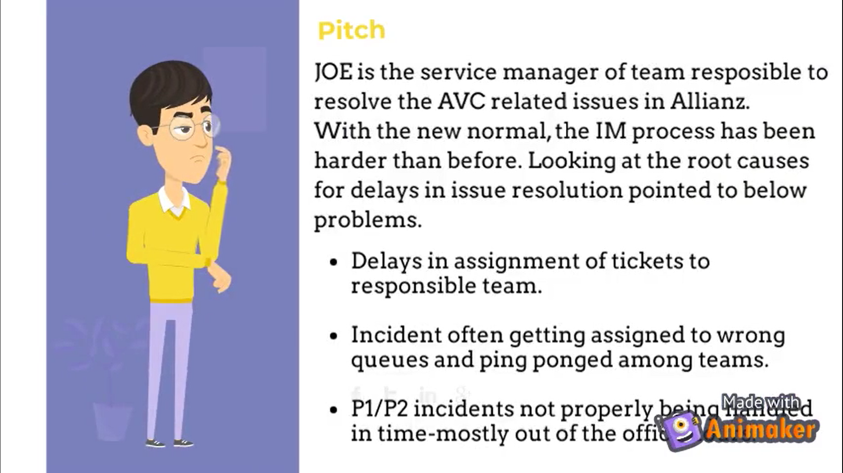

Slide 3
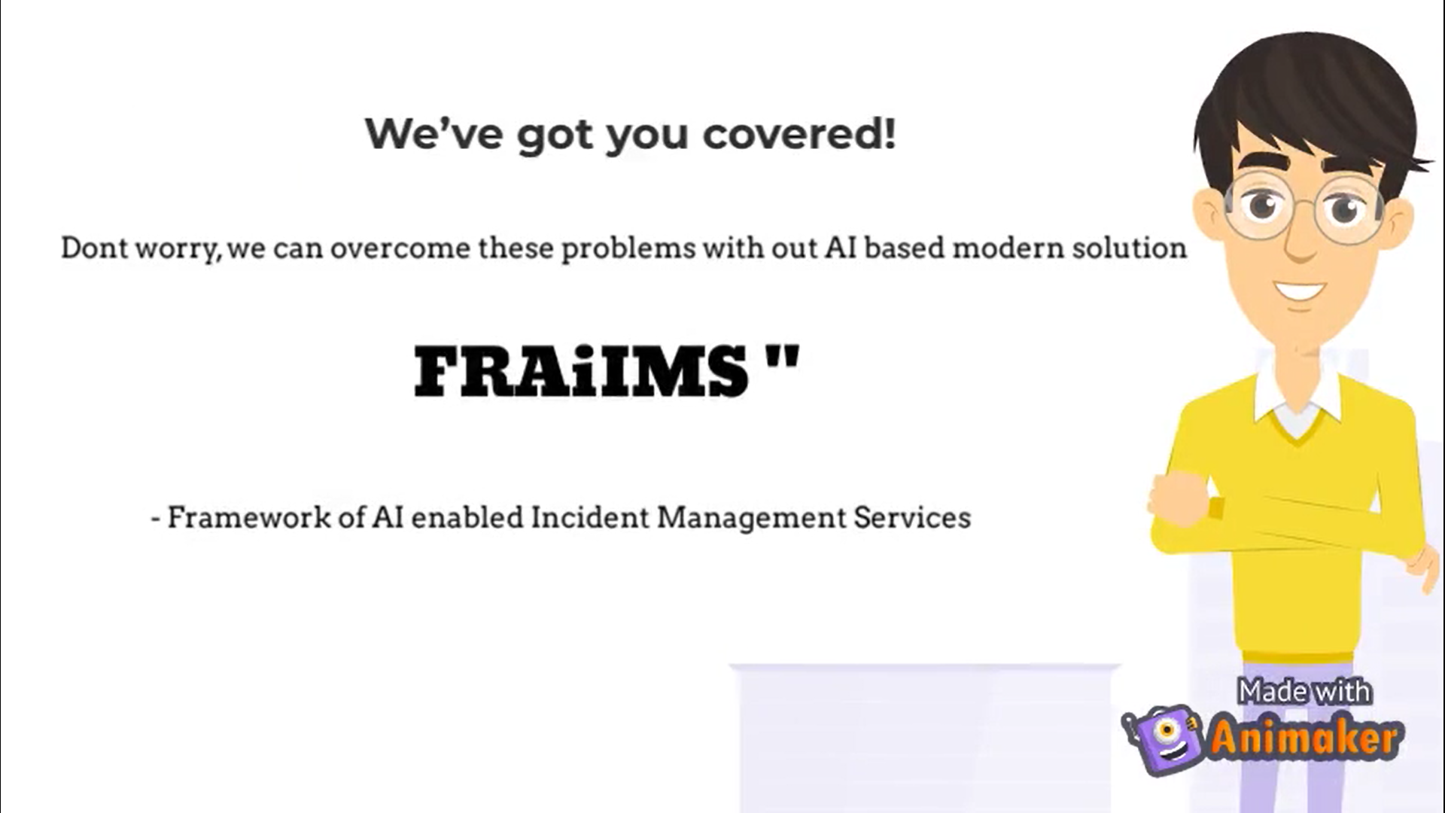

Slide 4
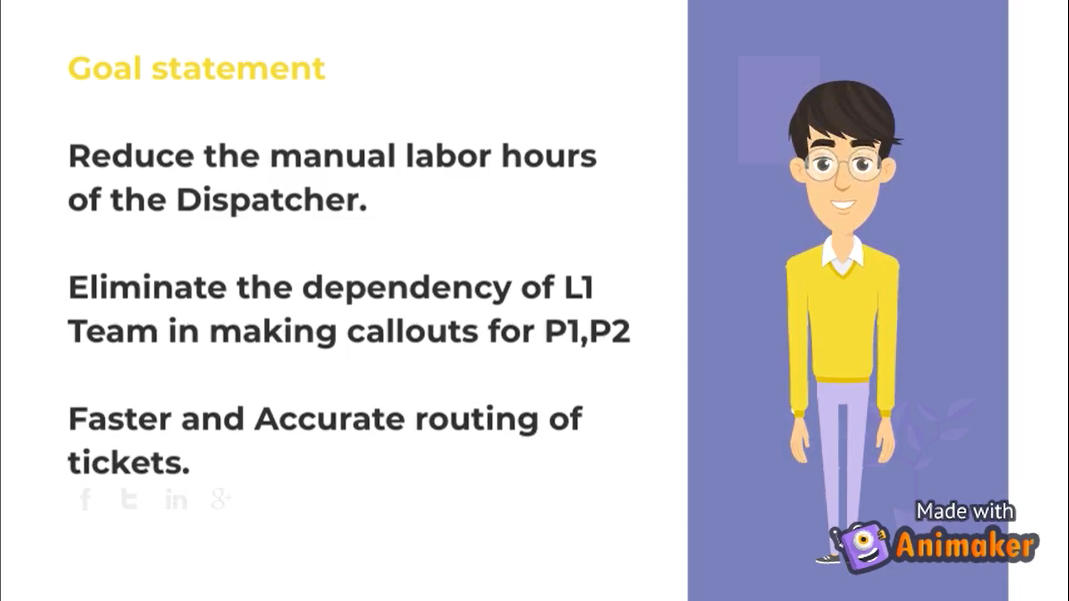

Slide 5
FRAiIMS –Front End
Application Enrolment
Support Definition
Initial Model Creation
Model Revision
Model Testing
Reports Module (Future)
Service Now
FRAiIMS –DB
Ticket assignment audit
Ticket Creation audit
Call Serviceaudit
API
FRAiIMS –Back End
Application Related Data
Support Rota
Ticket Assignment Service
GET ( All new inidents from SNOW API)
POST ( Assign incidents in SNOW API based on rules from DB )
Stores Audit
ClickSend.com
Ticket Creation Service
Polls for new emails in the support mailbox
Creates new ticket parameters and (posts) invokes Ticket Assignment service
Stores Audit
FRAiIMS –MailBox
API
Inbox- Ticket creation on demand
Intelligent Call Service
GET ( All new P1/P2 incidents from SNOW)
POST(Call text to ClickSend.com)
GET( Response from ClickSend API)
POST(Send test to clicksend.com for Redial or escalation)
Stores Audit

Slide 6
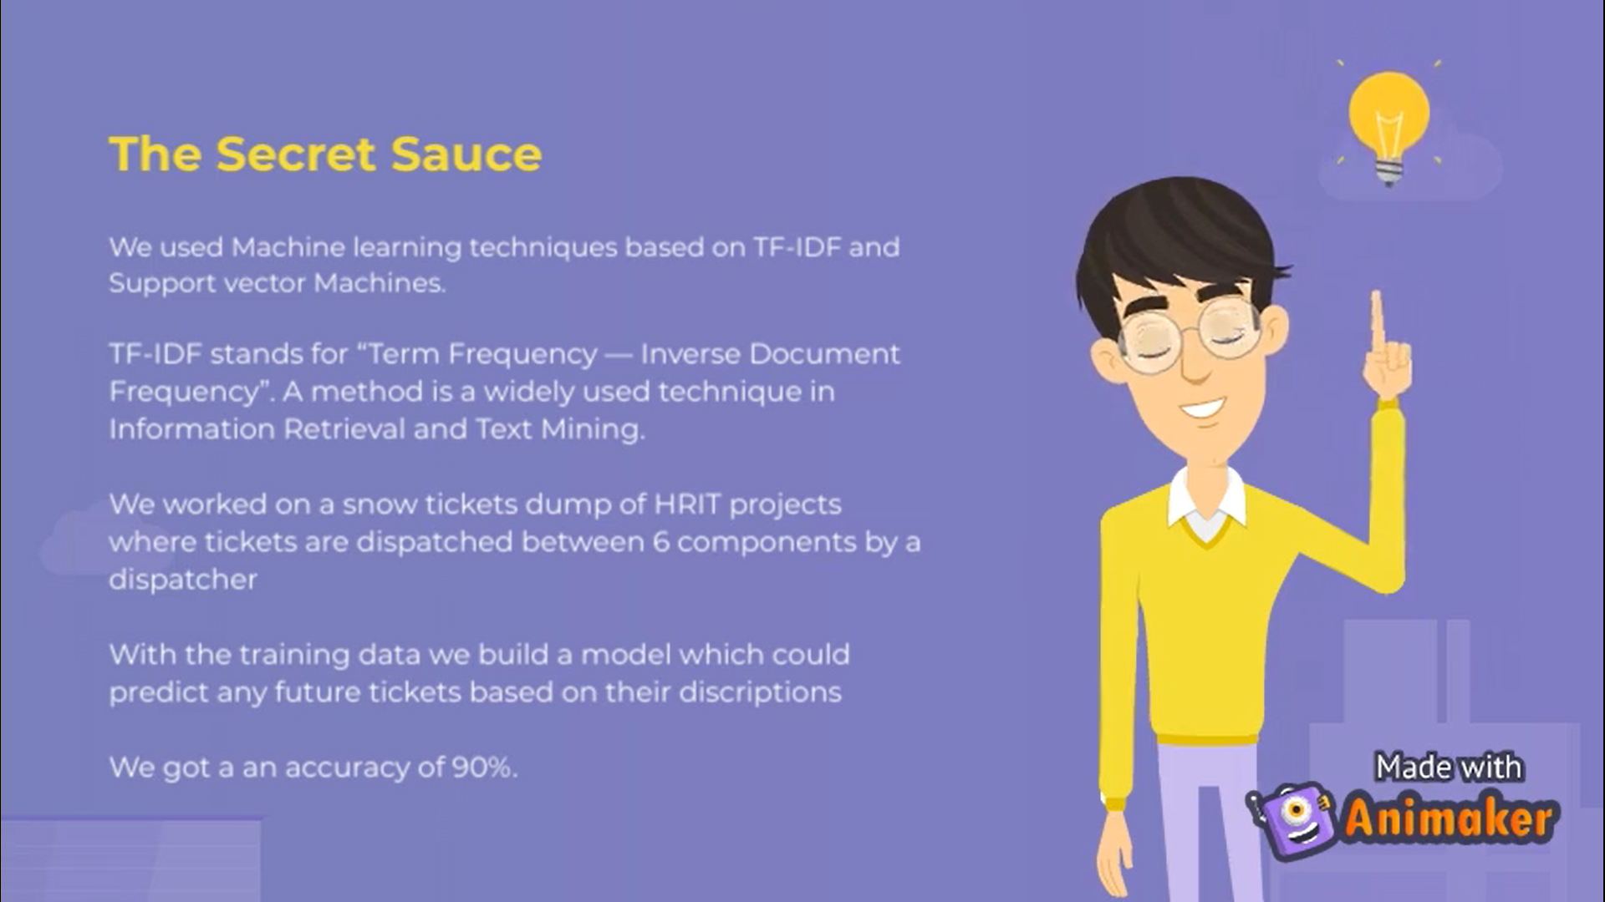

Slide 7
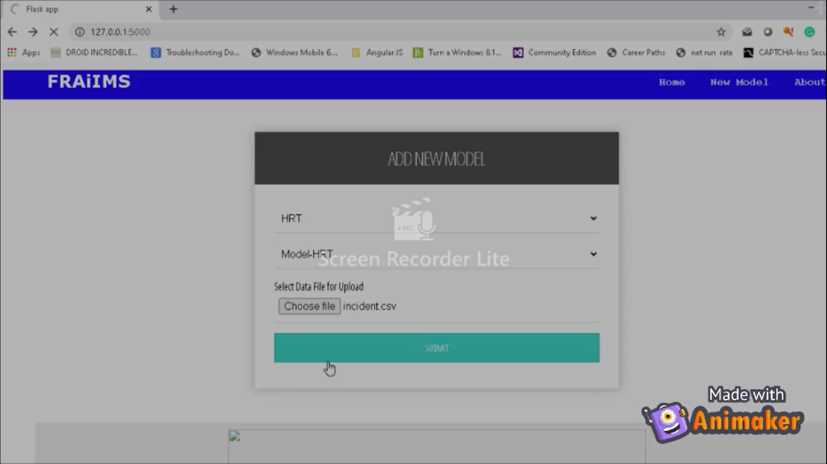

Slide 8
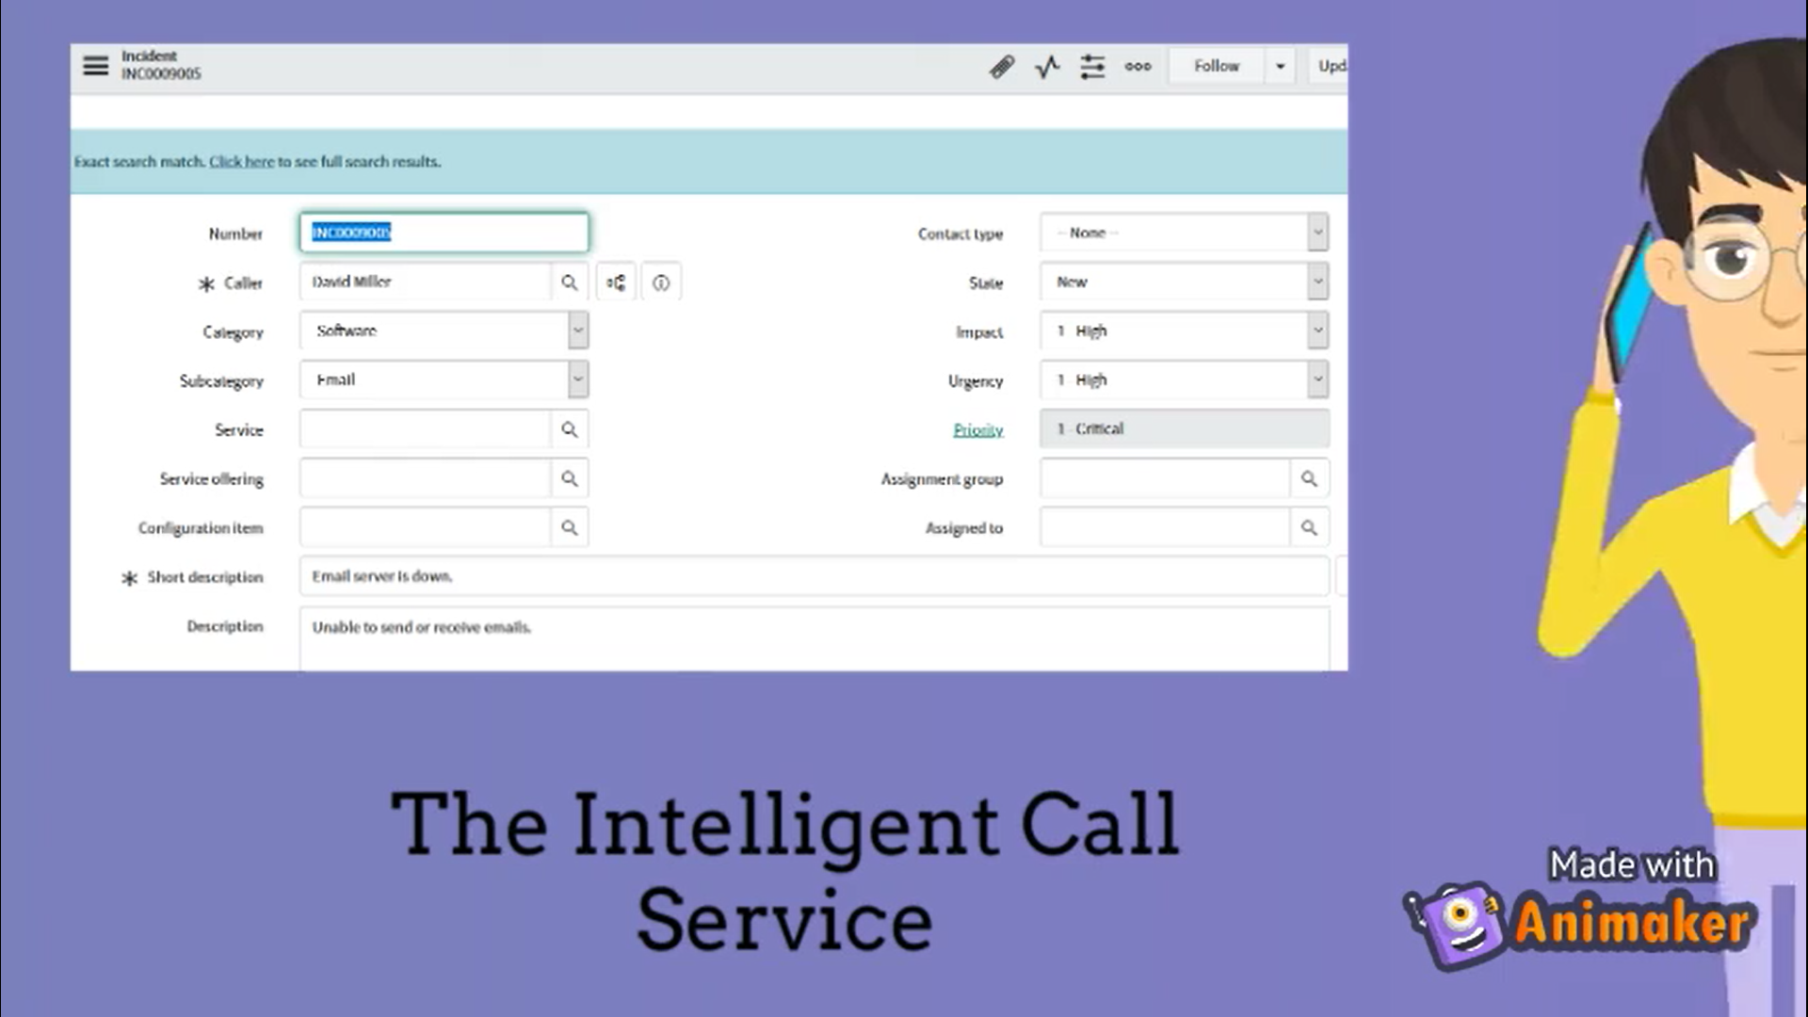

Slide 9
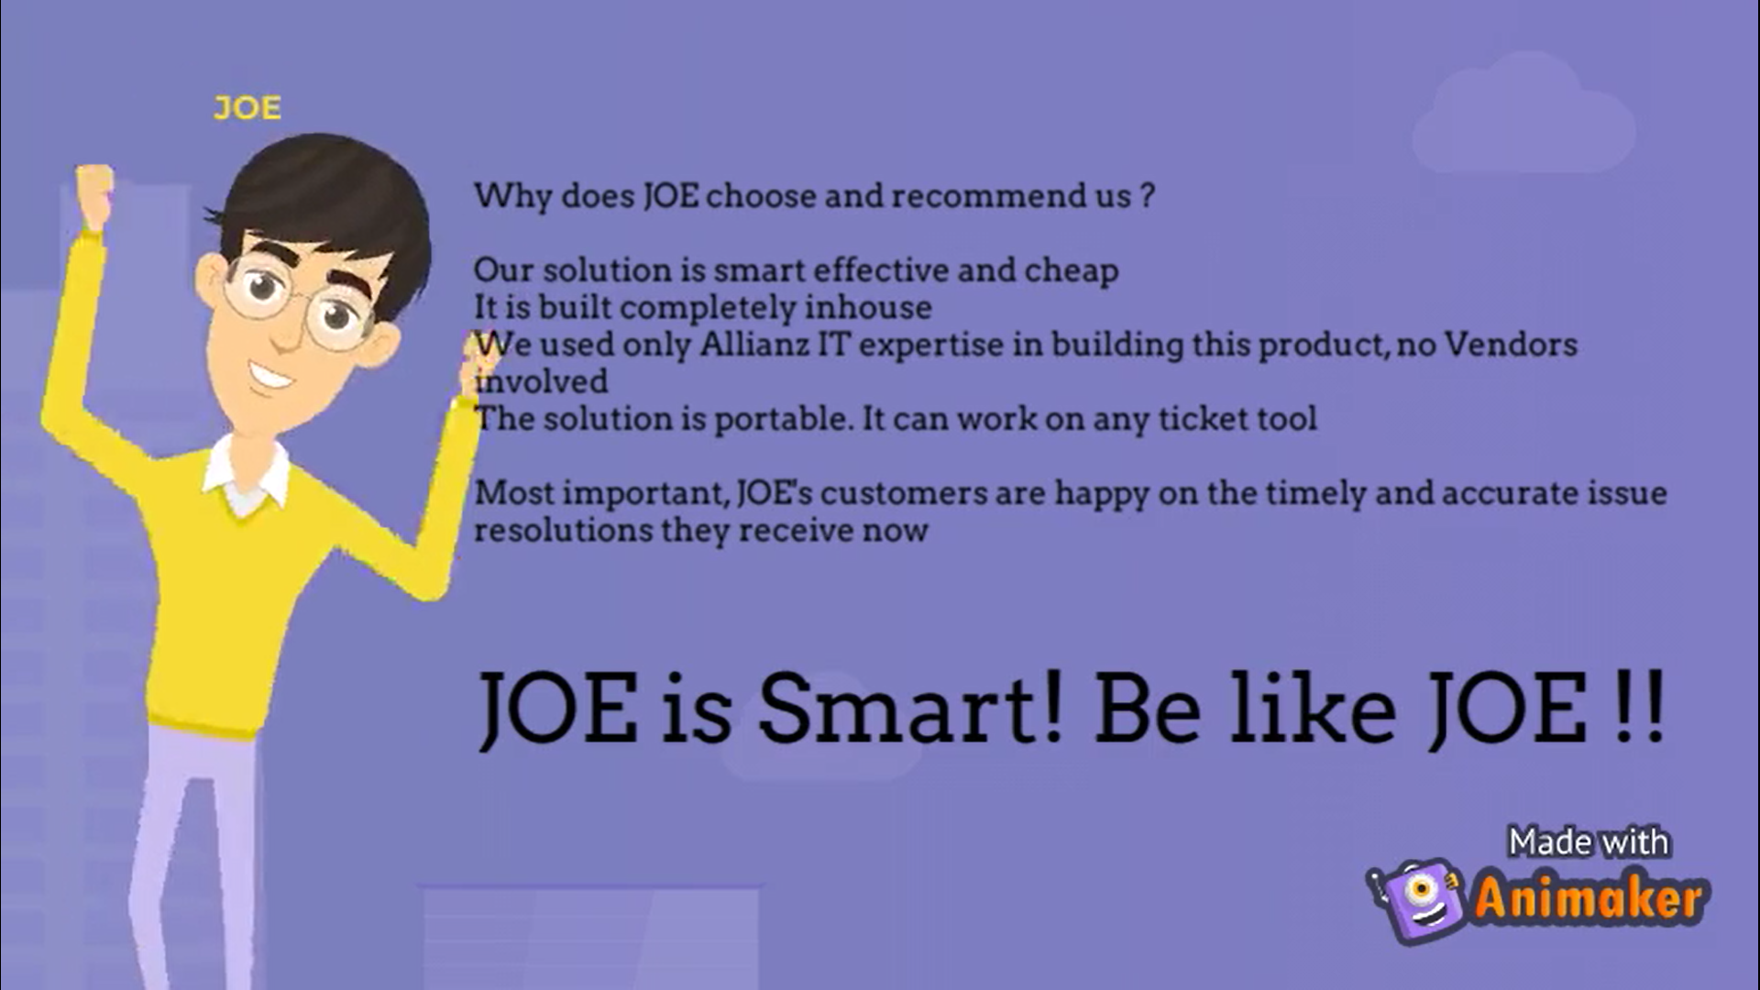

Slide 10











Technology Used:-

Slide 11
